Slide 1
CSE 320: Caches
Chapter 6
Professor Dan Benz

Slide 2
Caches
Cache: A smaller, faster storage device that acts as a staging area for a subset of the data in a larger, slower device.
Fundamental idea of a memory hierarchy:
  For each k, the faster, smaller device at level k serves as a cache for the larger, slower device at level k+1.
Why do memory hierarchies work?
  Because of locality, programs tend to access the data at level k more often than they access the data at level k+1.
  Thus, the storage at level k+1 can be slower, and thus larger and cheaper per bit.
Big Idea: The memory hierarchy creates a large pool of storage that costs as much as the cheap storage near the bottom, but that serves data to programs at the rate of the fast storage near the top.

Slide 3
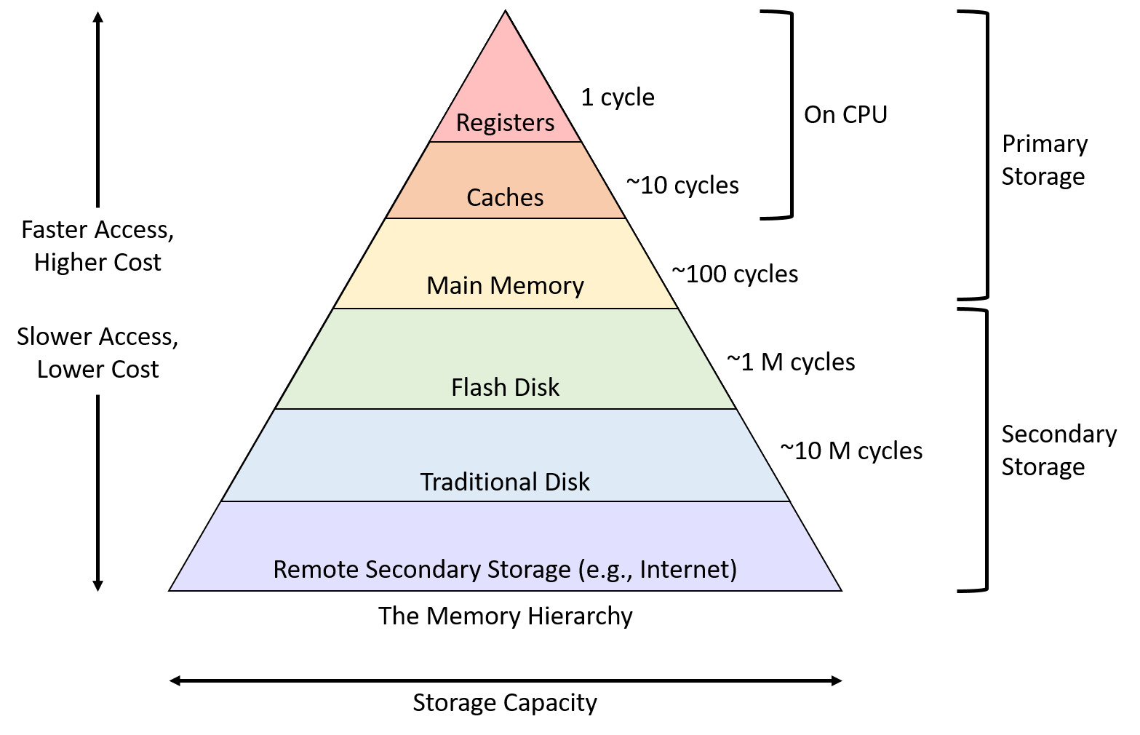
The Memory Hierarchy:

Slide 4
General Cache Concepts
Smaller, faster, more expensive
memory caches a subset of
the blocks
Cache
8
4
9
14
10
3
Data is copied in block-sized transfer units
4
10
Larger, slower, cheaper memory
viewed as partitioned into “blocks”
Memory
0
1
2
3
4
4
5
6
7
8
9
10
10
11
12
13
14
15

Slide 5
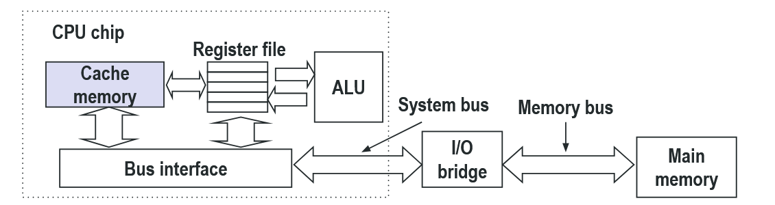
Cache Memories
Cache memories are small, fast SRAM-based memories managed automatically in hardware
  Hold frequently accessed blocks of main memory
CPU looks first for data in cache
Typical system structure:

Slide 6
Cache Architectures:
Direct Mapped
  Every address in RAM has 1 cache block that it can use
  Lines = 1
Fully Associative
  “No assigned seats”
  Any RAM address can be stored in any cache block
  Sets = 1
Set-Associative
  Every address in RAM has 1 cache set that it can use
  Middle ground idea

Slide 7
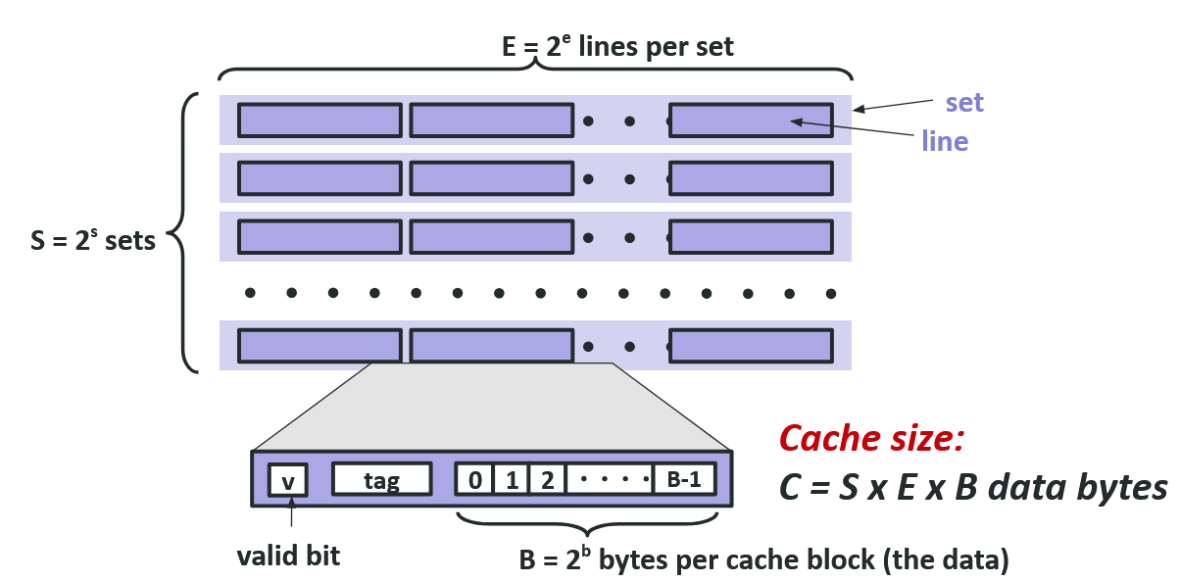
General Cache Organization (S, E, B)

Slide 8
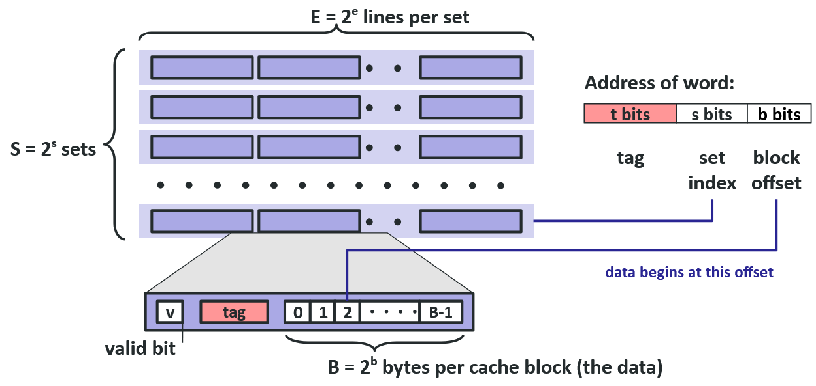
Cache Read

Slide 9
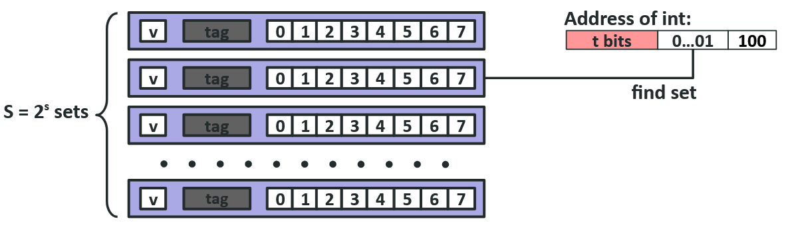
Example: Direct Mapped Cache (E = 1)
Direct mapped: One line per set
Assume: cache block size 8 bytes

Slide 10
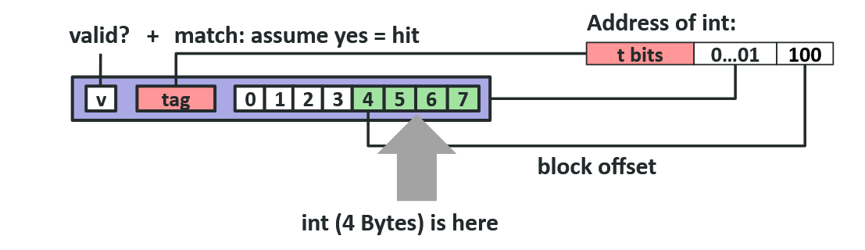
Example: Direct Mapped Cache (E = 1) Access
Direct mapped: One line per set
Assume: cache block size 8 bytes
If tag doesn’t match: old line is evicted and replaced

Slide 11
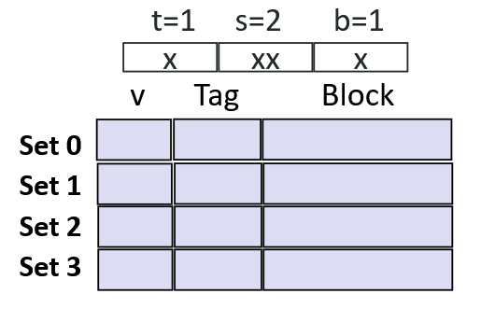
Direct-Mapped Cache Simulation
M=16 bytes (4-bit addresses)
B=2 bytes/block
S=4 sets
E=1 Blocks/set
Address trace (reads, one byte per read):
0 [0 00 0₂],
1 [0 00 1₂],
7 [0 11 1₂],
8 [1 00 0₂],
0 [0 00 0₂]

Slide 12
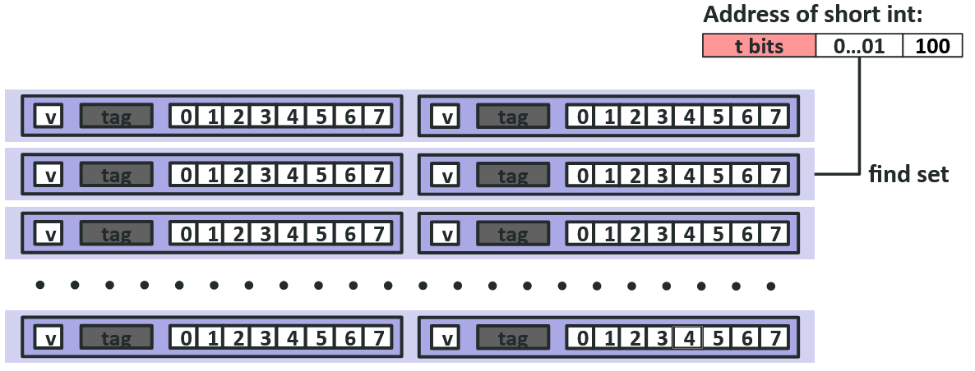
E-way Set Associative Cache (Here: E = 2)
E = 2: Two lines per set
Assume: cache block size 8 bytes

Slide 13
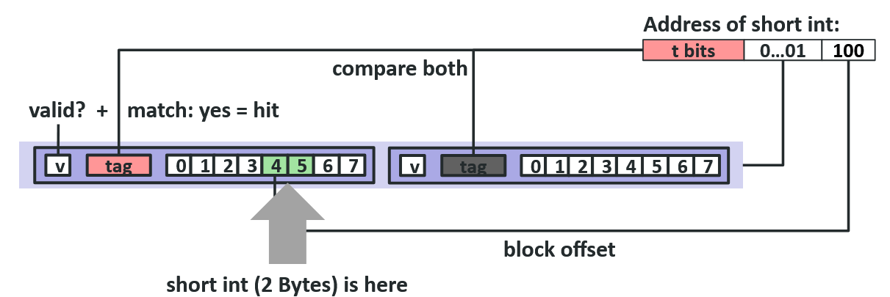
E-way Set Associative Cache (Here: E = 2) Access
E = 2: Two lines per set
Assume: cache block size 8 bytes
No match:
One line in set is selected for eviction and replacement
Replacement policies: random, least recently used (LRU), …

Slide 14
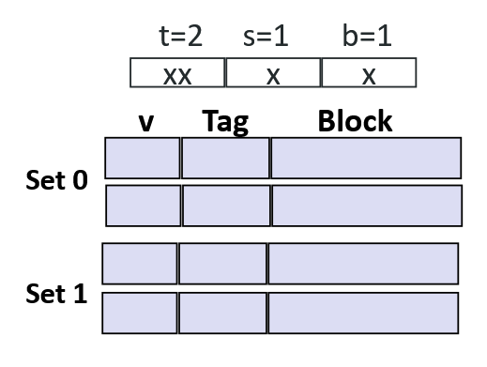
2-Way Set Associative Cache Simulation
M=16 byte addresses
B=2 bytes/block
S=2 sets
E=2 blocks/set
Address trace (one byte per read):
0 [00 0 0₂],
1 [00 0 1₂],
7 [01 1 1₂],
8 [10 0 0₂],
0 [00 0 0₂]

Slide 15
What about writes?
Multiple copies of data exist: L1, L2, L3, Main Memory, Disk
What to do on a write-hit?
  Write-through (write immediately to memory)
  Write-back (defer write to memory until replacement of line)
    Need a dirty bit (line different from memory or not)
What to do on a write-miss?
  Write-allocate (load into cache, update line in cache)
    Good if more writes to the location follow
  No-write-allocate (writes straight to memory, does not load into cache)
Typical
  Write-through + No-write-allocate
  Write-back + Write-allocate

Slide 16

Cache Eviction
Cache Eviction:
  removing cache data to make space for new data
No decision for direct mapped cache
Need to decide for set-associative cache
A number of different policies exist:
  Optimal/Clairvoyant
  Random
  First-in First-out (FIFO)
  Least Recently Used (LRU)
  Least Frequently Used (LFU)

Slide 17
Best Policy?
Optimal/Clairvoyant:
  Look forward and pick the block used last/never. Why is this not used in practice?
Random
  Pick randomly. Why would you pick this option?
FIFO
  Timestamp the block loading, pick the oldest. Why might this be bad?
LRU
  Timestamp the block access, pick the oldest. Is this harder than FIFO?
LFU
  Count the number of accesses to a line. What access pattern does this assume?

Slide 18
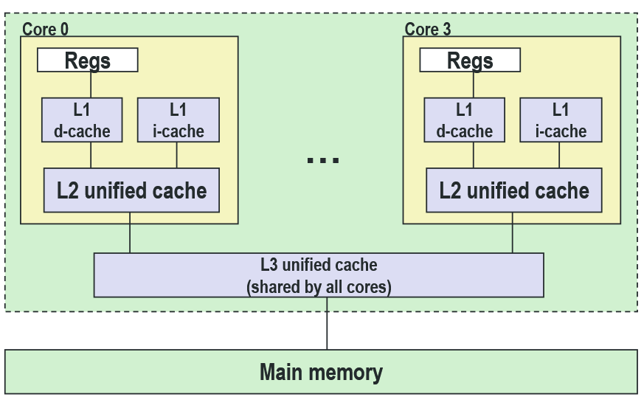
Intel Core i7 Cache Hierarchy
L1 i-cache & d-cache:
  32 KB, 8-way,
  Access: 4 cycles
L2 unified cache:
  256 KB, 8-way,
  Access: 10 cycles
L3 unified cache:
  8 MB, 16-way,
  Access: 40-75 cycles
Block size:
  Always 64 bytes

Slide 19
Cache Performance Metrics
Miss Rate
  Fraction of memory references not found in cache (misses / accesses) = 1 – hit rate
  Typical numbers (in percentages):
    3-10% for L1
    can be quite small (e.g., < 1%) for L2, depending on size, etc.
Hit Time
  Time to deliver a line in the cache to the processor
    includes time to determine whether the line is in the cache
  Typical numbers:
    4 clock cycle for L1
    10 clock cycles for L2
Miss Penalty
  Additional time required because of a miss
    typically 50-200 cycles for main memory (Trend: increasing!)

Slide 20
Let’s think about those numbers
Huge difference between a hit and a miss
  Could be 100x, if just L1 and main memory
Would you believe 99% hits is twice as good as 97%?
  Consider:
    cache hit time of 1 cycle
    miss penalty of 100 cycles
  Average access time:
    97% hits: 1 cycle + 0.03 * 100 cycles = 4 cycles
    99% hits: 1 cycle + 0.01 * 100 cycles = 2 cycles
This is why “miss rate” is used instead of “hit rate”

Slide 21
Writing Cache Friendly Code
Make the common case go fast
  Focus on the inner loops of the core functions
Minimize the misses in the inner loops
  Repeated references to variables are good (temporal locality)
  Stride-1 reference patterns are good (spatial locality)
Key idea: Our qualitative notion of locality is quantified through our understanding of cache memories

Slide 22
The Memory Mountain
Read throughput (read bandwidth)
  Number of bytes read from memory per second (MB/s)
Memory mountain:
  Measured read throughput as a function of spatial and temporal locality.
  Compact way to characterize memory system performance.

Slide 23
Memory Mountain Test Function
long data[MAXELEMS]; /* Global array to traverse */
/* test - Iterate over first "elems" elements of
* array “data” with stride of "stride", using
* using 4x4 loop unrolling.
*/
int test(int elems, int stride) {
long i, sx2=stride*2, sx3=stride*3, sx4=stride*4;
long acc0 = 0, acc1 = 0, acc2 = 0, acc3 = 0;
long length = elems, limit = length - sx4;
/* Combine 4 elements at a time */
for (i = 0; i < limit; i += sx4) {
acc0 = acc0 + data[i];
acc1 = acc1 + data[i+stride];
acc2 = acc2 + data[i+sx2];
acc3 = acc3 + data[i+sx3];
}
/* Finish any remaining elements */
for (; i < length; i++) {
acc0 = acc0 + data[i];
}
return ((acc0 + acc1) + (acc2 + acc3));
}
Call test() with many combinations of elems and stride.
  For each elems and stride:
    Call test() once to warm up the caches.
    Call test() again and measure the read throughput(MB/s)

Slide 24
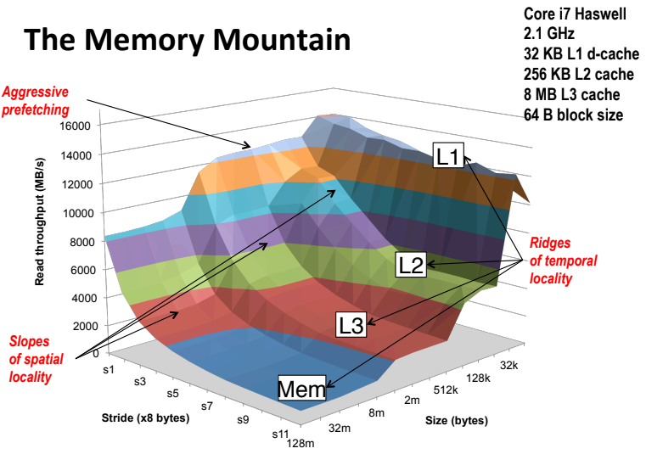
The Memory Mountain:

Slide 25
Matrix Multiplication Example
Description:
  Multiply N x N matrices
  Matrix elements are doubles (8 bytes)
  O(N³) total operations
  N reads per source element
  N values summed per destination
    but may be able to hold in register
/* ijk */
for (i=0; i<n; i++) {
for (j=0; j<n; j++) {
sum = 0.0;
for (k=0; k<n; k++)
sum += a[i][k] * b[k][j];
c[i][j] = sum;
}
}

Slide 26
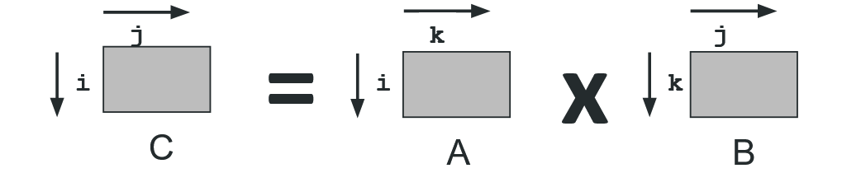
Miss Rate Analysis for Matrix Multiply
Assume:
  Block size = 32B (big enough for four doubles)
  Matrix dimension (N) is very large
    Approximate 1/N as 0.0
  Cache is not even big enough to hold multiple rows
Analysis Method:
  Look at access pattern of inner loop

Slide 27
Layout of C Arrays in Memory (review)
C arrays allocated in row-major order
  each row in contiguous memory locations
Stepping through columns in one row:
  for (i = 0; i < N; i++)
    sum += a[0][i];
  accesses successive elements
  if block size (B) > sizeof(a_{ij}) bytes, exploit spatial locality
    miss rate = sizeof(a_{ij}) / B
Stepping through rows in one column:
  for (i = 0; i < n; i++)
    sum += a[i][0];
  accesses distant elements
  no spatial locality!
    miss rate = 1 (i.e. 100%)

Slide 28
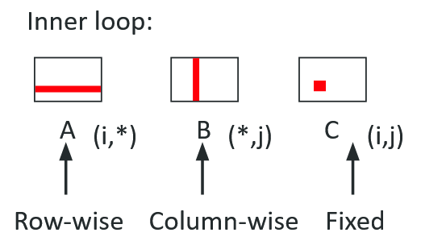
Matrix Multiplication (ijk) == (jik)
/* ijk */
for (i=0; i<n; i++) {
for (j=0; j<n; j++) {
sum = 0.0;
for (k=0; k<n; k++)
sum += a[i][k] * b[k][j];
c[i][j] = sum;
}
}
Misses per inner loop iteration:
  A: 0.25 B: 1.0 C: 0.0

Slide 29
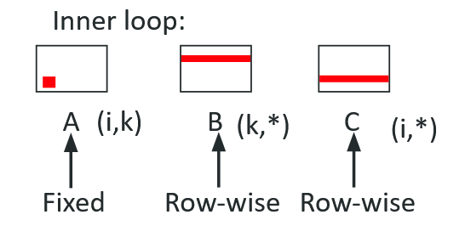
Matrix Multiplication (kij) == (ikj)
/* kij */
for (k=0; k<n; k++) {
for (i=0; i<n; i++) {
r = a[i][k];
for (j=0; j<n; j++)
c[i][j] += r * b[k][j];
}
}
Misses per inner loop iteration:
  A: 0.0 B: 0.25 C: 0.25

Slide 30
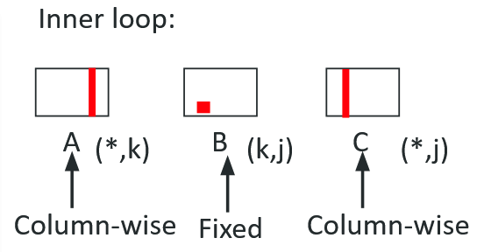
Matrix Multiplication (jki) == (kji)
/* jki */
for (j=0; j<n; j++) {
for (k=0; k<n; k++) {
r = b[k][j];
for (i=0; i<n; i++)
c[i][j] += a[i][k] * r;
}
}
Misses per inner loop iteration:
  A: 1.0 B: 0.0 C: 1.0

Slide 31
Summary of Matrix Multiplication
for (i=0; i<n; i++) {
for (j=0; j<n; j++) {
sum = 0.0;
for (k=0; k<n; k++)
sum += a[i][k] * b[k][j];
c[i][j] = sum; }}
ijk (& jik):
  2 loads, 0 stores
  misses/iter = 1.25
kij (& ikj):
  2 loads, 1 store
  misses/iter = 0.5
jki (& kji):
  2 loads, 1 store
  misses/iter = 2.0
for (k=0; k<n; k++) {
for (i=0; i<n; i++) {
r = a[i][k];
for (j=0; j<n; j++)
c[i][j] += r * b[k][j];}}
for (j=0; j<n; j++) {
for (k=0; k<n; k++) {
r = b[k][j];
for (i=0; i<n; i++)
c[i][j] += a[i][k] * r;}}

Slide 32
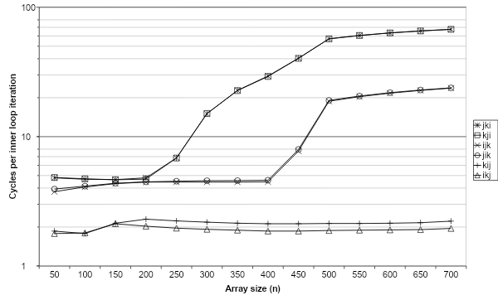
Core i7 Matrix Multiply Performance
jki / kji
ijk / jik
kij / ikj

Slide 33
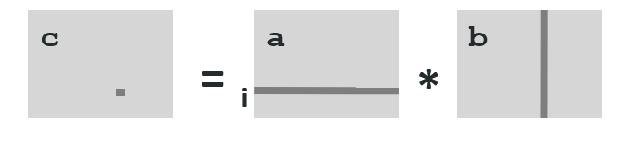
Example: Matrix Multiplication
c = (double *) calloc(sizeof(double), n*n);
/* Multiply n x n matrices a and b */
void mmm(double *a, double *b, double *c, int n) {
int i, j, k;
for (i = 0; i < n; i++)
for (j = 0; j < n; j++)
for (k = 0; k < n; k++)
c[i*n + j] += a[i*n + k] * b[k*n + j];
}
j

Slide 34
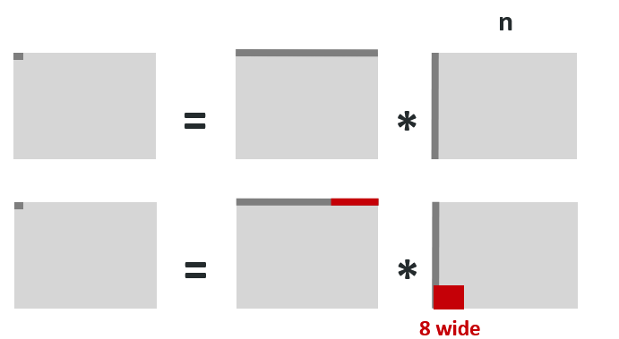

Cache Miss Analysis (unblocked)
Assume:
  elements are doubles
  Cache block = 8 doubles
  Cache size C << n
Each Loop:
  n/8 (input) + n (weights) = 9n/8 misses
N² total loops for all outputs
Total misses:
  9n/8 * n² = (9/8) * n³

Slide 35
Cache Miss Analysis (unblocked)
Assume:
  elements are doubles
  Cache block = 8 doubles
  Cache size C << n
Each Loop:
  n/8 (output) + n/8 (weights) = n/4 misses
N² total loops for all outputs
Total misses:
  n/4 * n² = (1/4) * n³

Slide 36
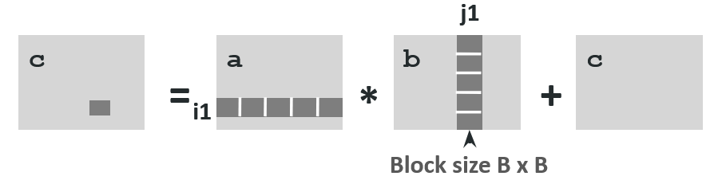
Blocked Matrix Multiplication
c = (double *) calloc(sizeof(double), n*n);
/* Multiply n x n matrices a and b */
void mmm(double *a, double *b, double *c, int n) {
int i, j, k;
for (i = 0; i < n; i+=B)
for (j = 0; j < n; j+=B)
for (k = 0; k < n; k+=B)
/* B x B mini matrix multiplications */
for (i1 = i; i1 < i+B; i1++)
for (j1 = j; j1 < j+B; j1++)
for (k1 = k; k1 < k+B; k1++)
c[i1*n+j1] += a[i1*n + k1]*b[k1*n + j1];
}

Slide 37
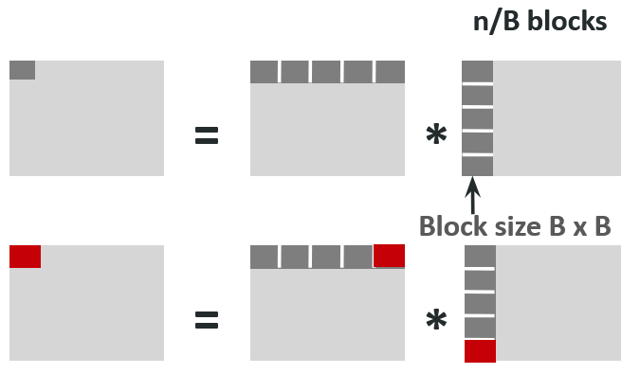
Cache Miss Analysis (blocked)
Assume:
  Cache block = 8 doubles
  Cache size C << n
  3 blocks fit into cache: 3B² < C
Each Loop:
  B²/8 misses for each block
    B/8 per row, B rows
  n/B blocks for each matrix (x2)
  2n/B * B²/8 = nB/4
    +matrix c
(N/B)² total loops for all outputs
Total misses:
  nB/4 * (n/B)² = n³/(4B)

Slide 38
Blocking Summary
No blocking: (1/4) * n³
Blocking: 1/(4B) * n³
Suggest largest possible block size B, but limit 3B² < C
Reason for dramatic difference:
  Matrix multiplication has inherent temporal locality:
    Input data: 3n², computation 2n³
    Every array elements used O(n) times!
  But program has to be written properly

Slide 39
Cache Summary
Cache memories can have significant performance impact
You can write your programs to exploit this!
  Focus on the inner loops, where bulk of computations and memory accesses occur.
  Try to maximize spatial locality by reading data objects with sequentially with stride 1.
  Try to maximize temporal locality by using a data object as often as possible once it’s read from memory.

